Slide 1
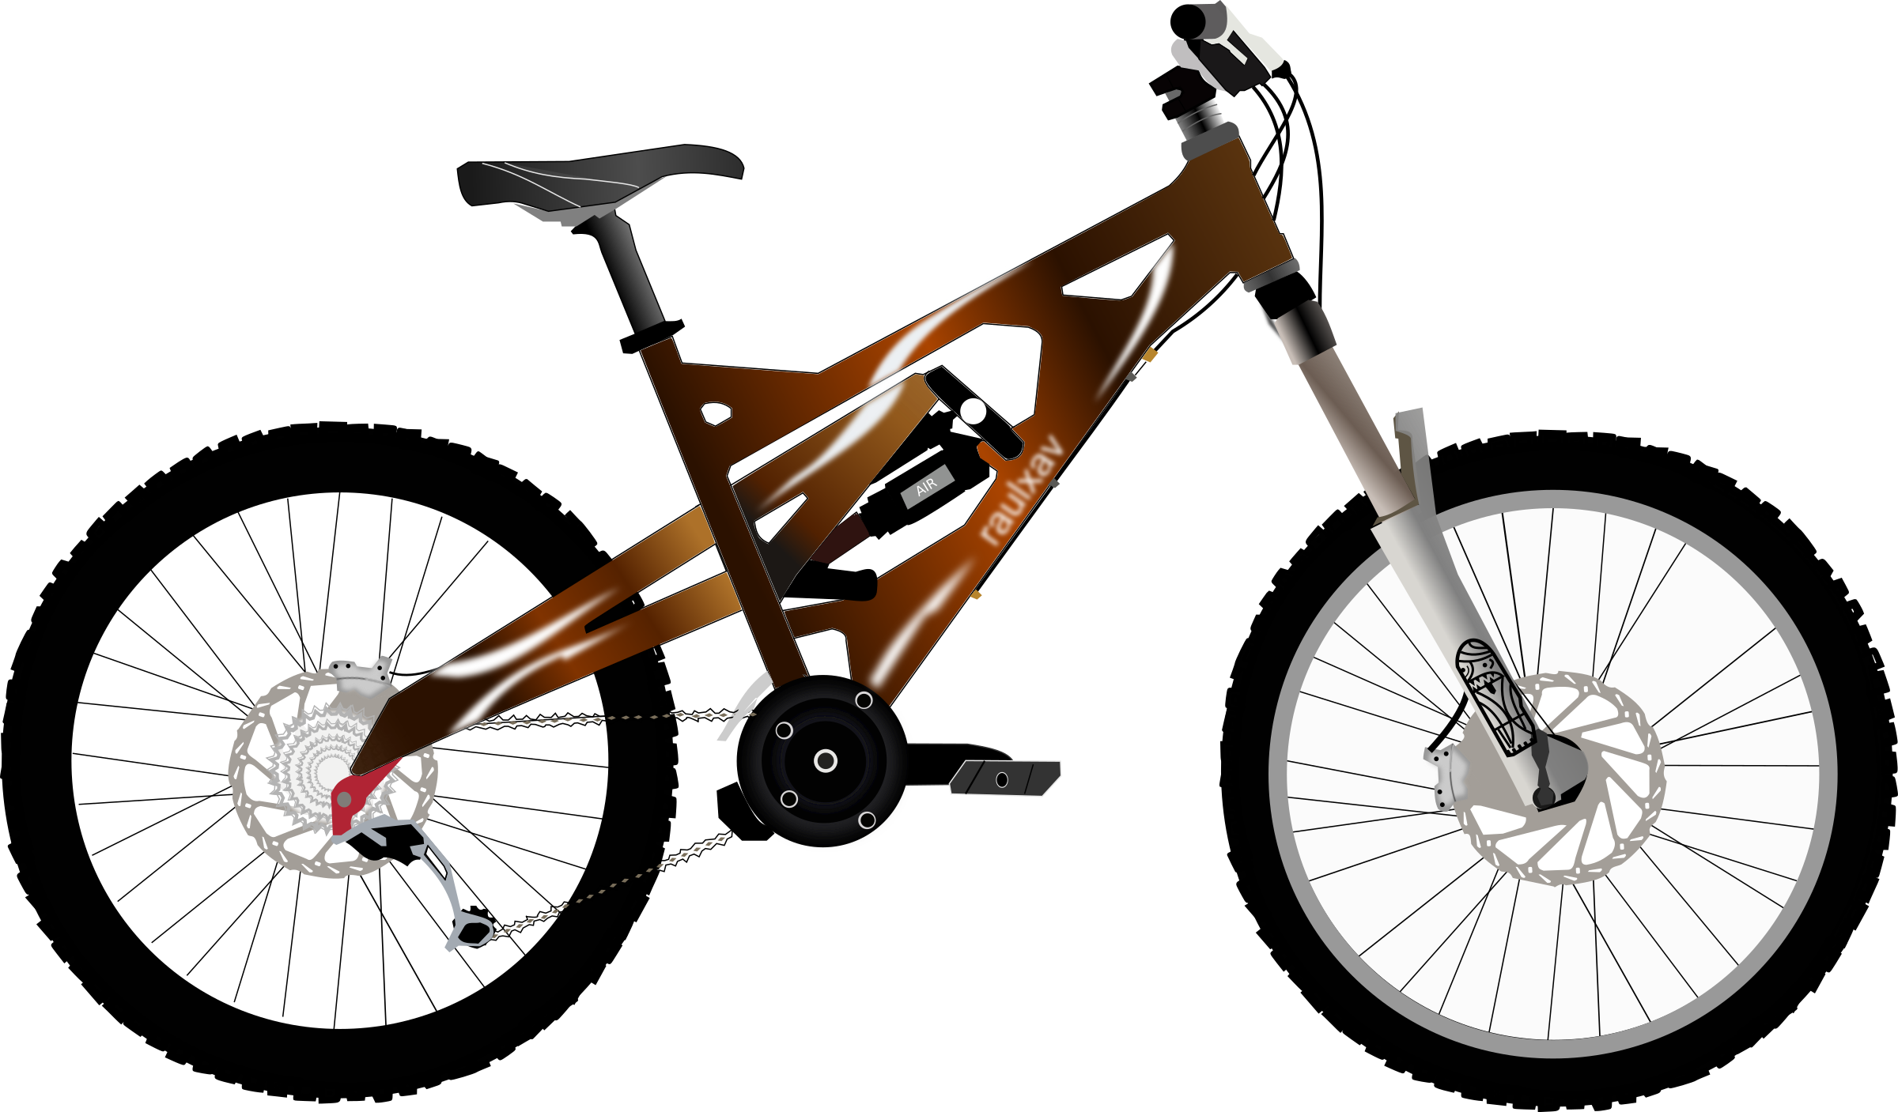
Bike Sharing Demand Project
Project Name: Bike Sharing Demand
Company name : Hext Hike IT Solution
Introduction:
Hi
My name Priyanshi Jambukiya, I’m from Ahmedabad Gujarat.
Thanks,

Slide 2
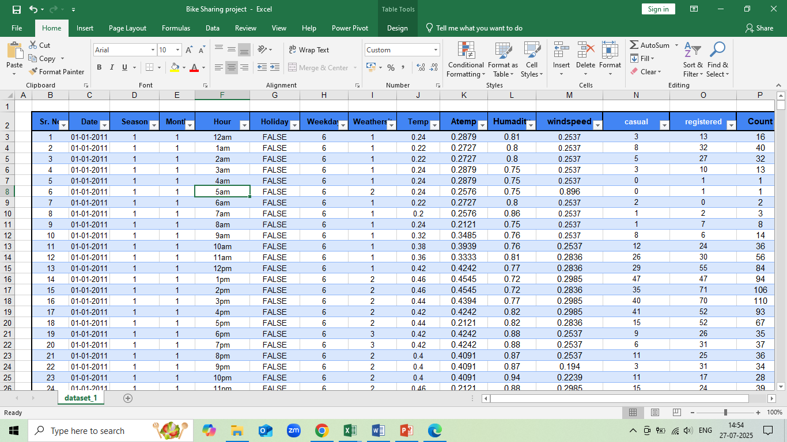
Data Cleaning

Slide 3
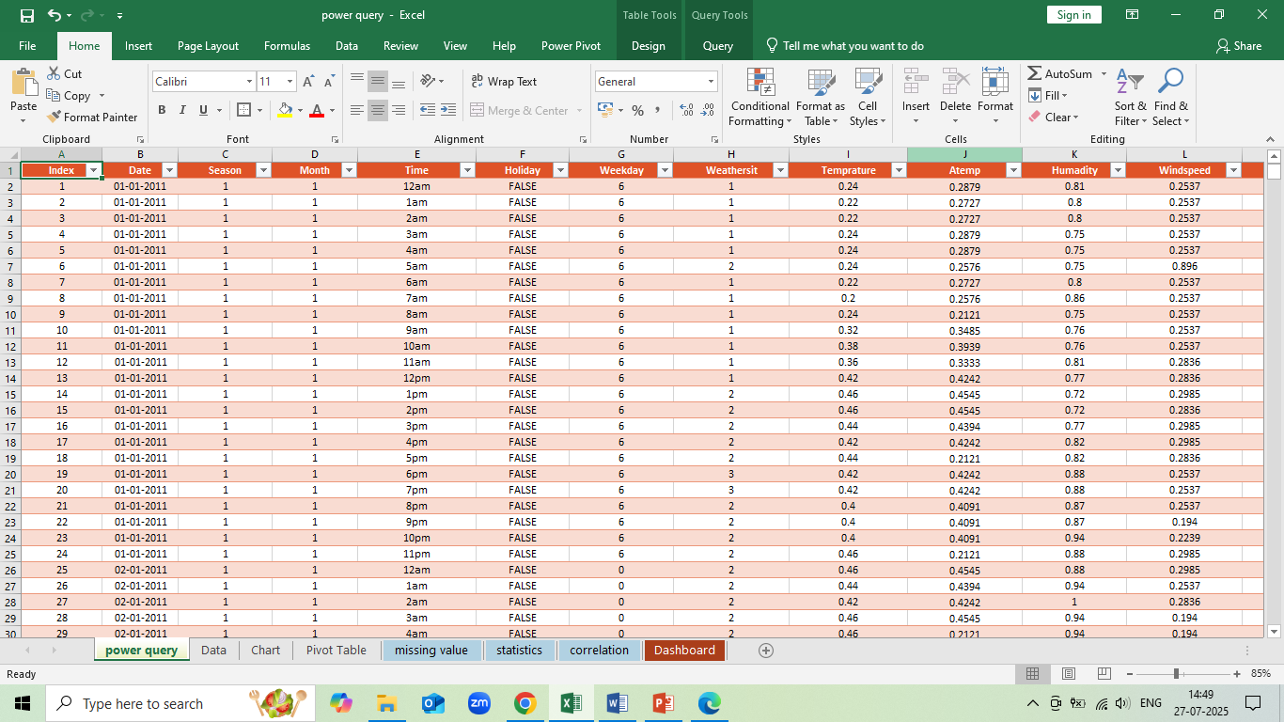
Power Query

Slide 4
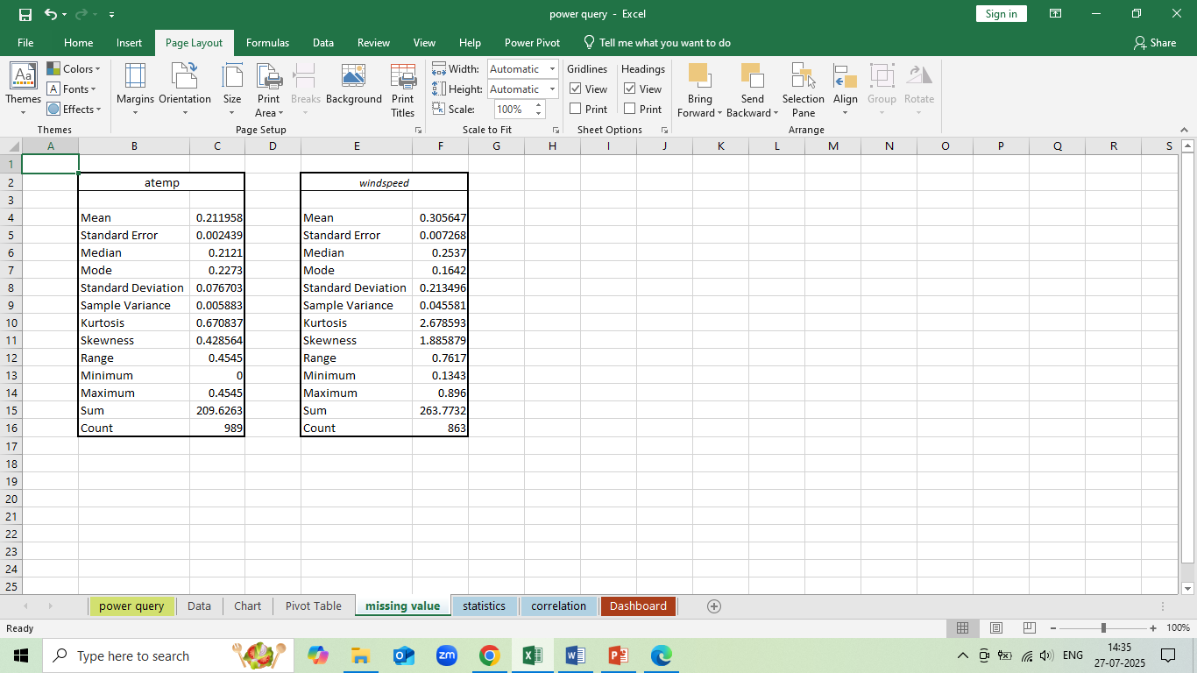
Missing value

Slide 5
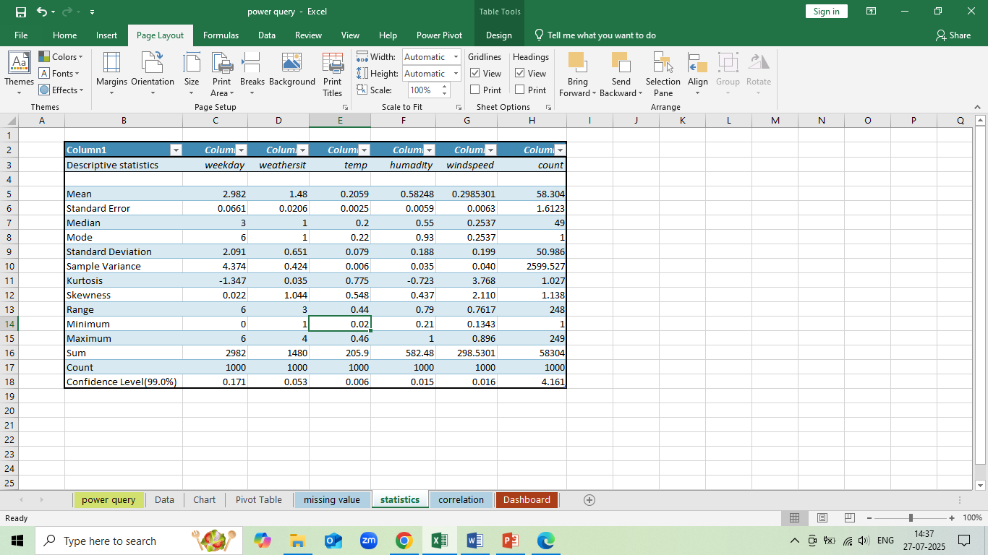
Statistic's

Slide 6
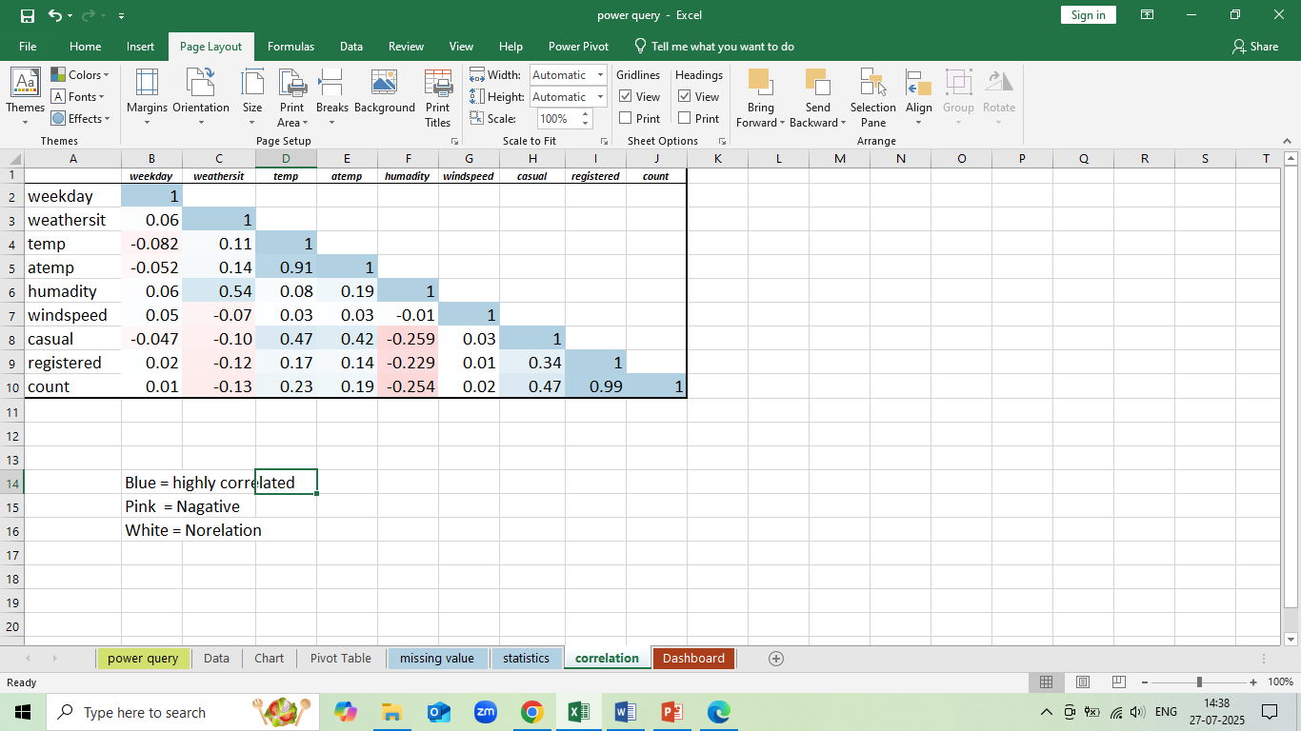
Correlated value

Slide 7
INDEX MATCH & VLOOK UP
INDEX MATCH
Hour | Temprature | Atemp | Humadity | Windspeed | Casual | Registered | Count
12am | 0.24 | 0.24 | 0.2879 | 0.81 | 0.2537 | 3 | 13
 |  | V LOOK UP
 |  | Temp | Humadity | Windspeed | Casual | Registered | Count
 |  | 0.24 | 0.81 | 0.2537 | 3 | 13 | 16

Slide 8
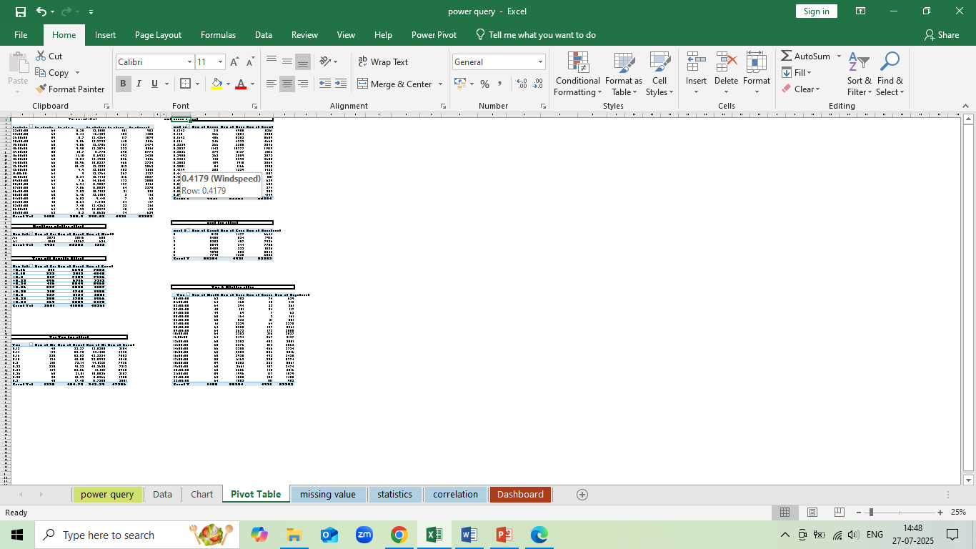
Pivot Table

Slide 9
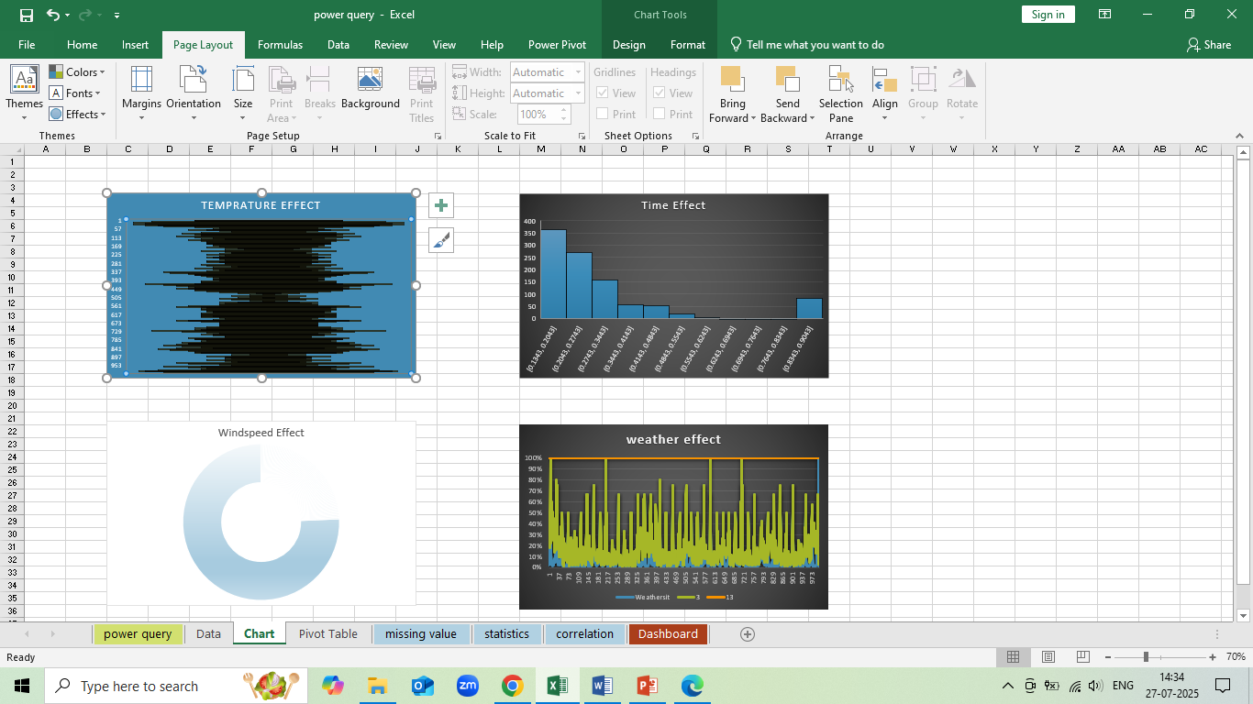
Charts

Slide 10
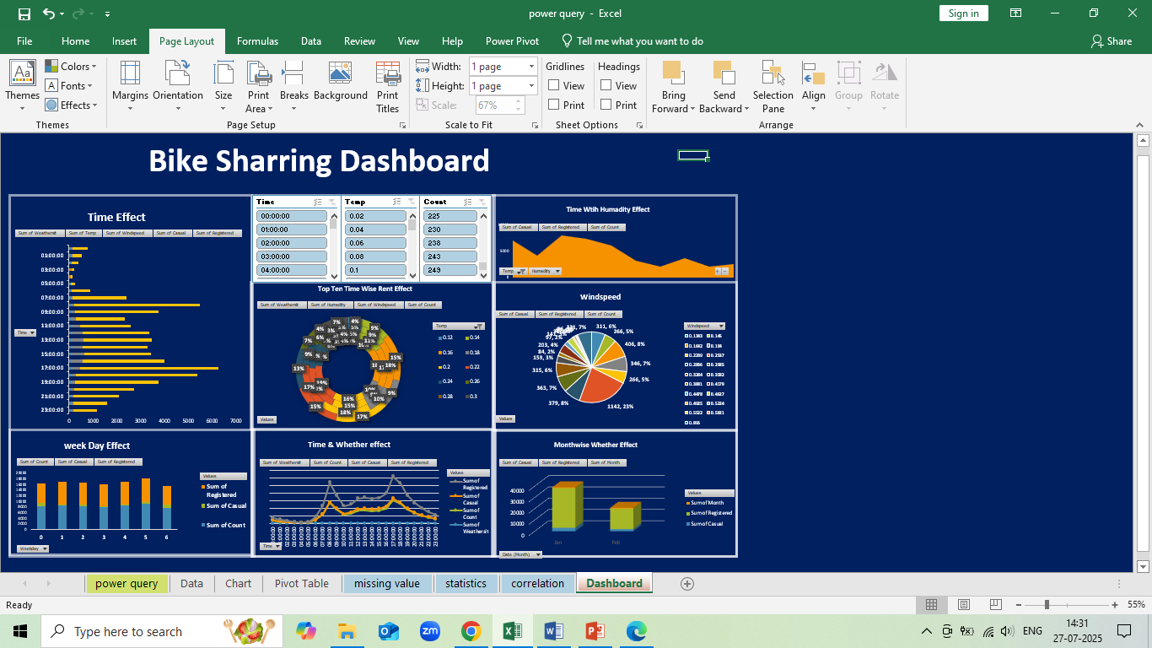
Dashboard

